Slide 1
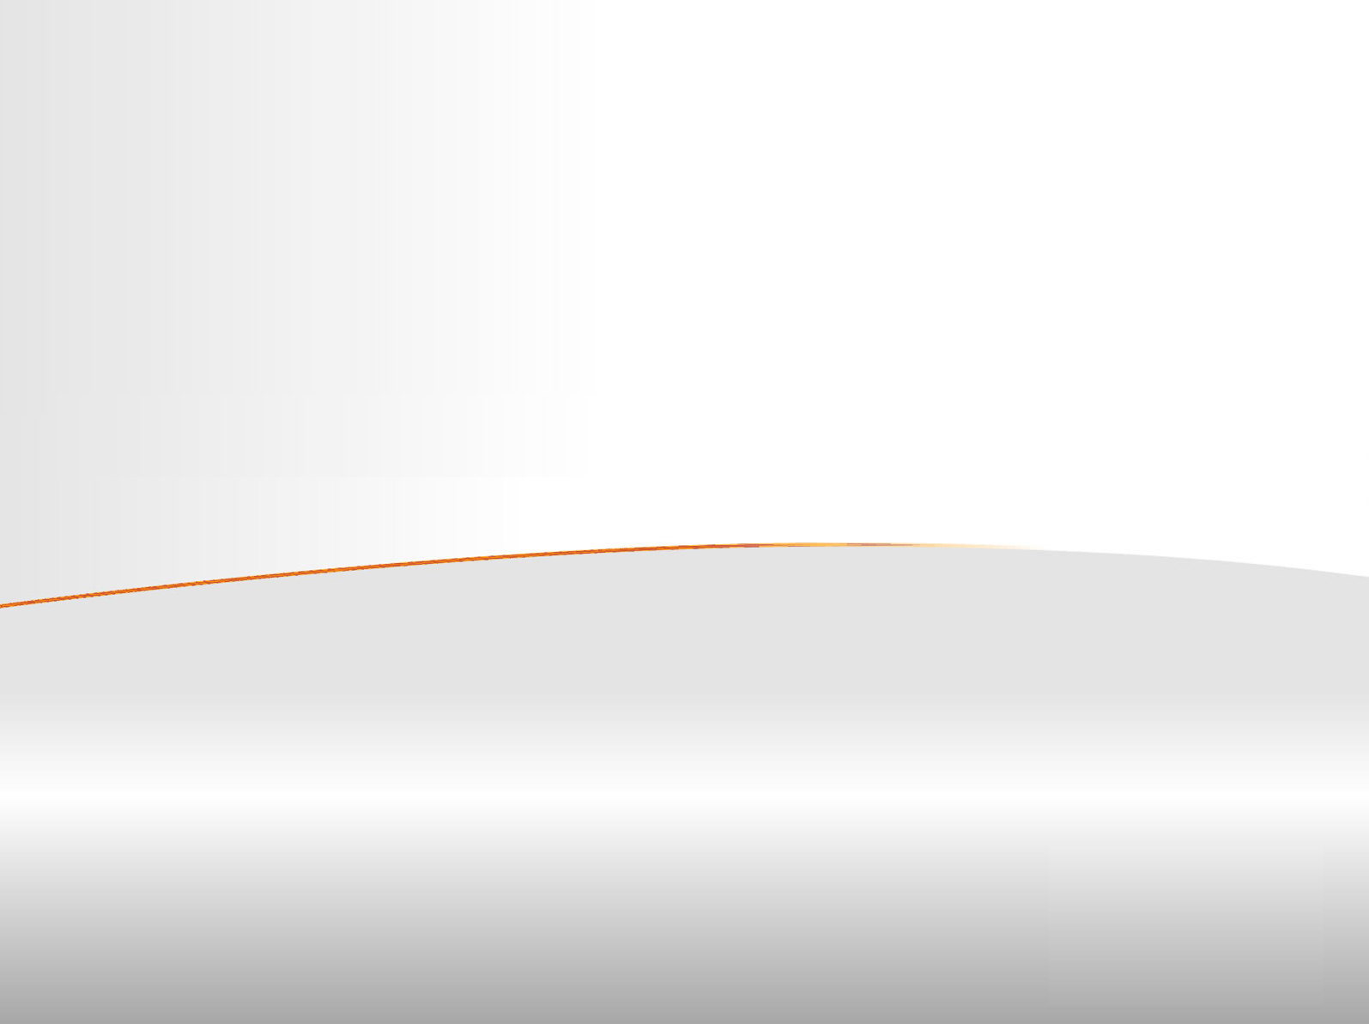
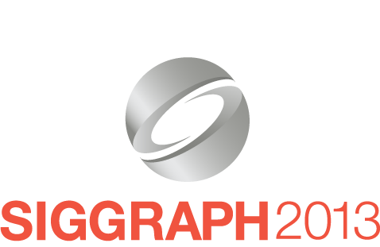
Advanced Light Transport in the VFX/Archiviz industry
Juan Cañada – Head of Maxwell Render
Next Limit Technologies

Slide 2
Agenda
Introduction
Existing barriers
Possible solutions
Next steps
Recent Advances in Light Transport Simulation: Theory & Practice
Notes:
Jaroslav, Iliyan and Anton have talked extensively about the state-of-the art light transport algorithms. I will talk about how the industry applies this knowhow. And specifically I will talk about which parts are not used yet, and why. I will focus on existing barriers, possible solutions and next steps that will probably be taken.

Slide 3
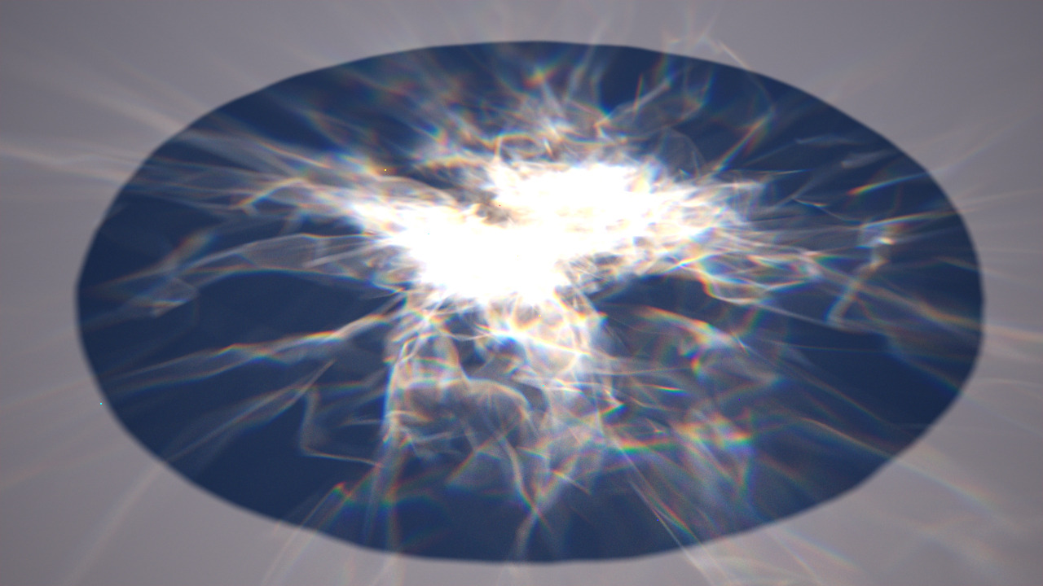
Advanced Light Transport why
Research on light transport allows us to simulate complex scenarios
Recent Advances in Light Transport Simulation: Theory & Practice
Notes:
Nowadays techniques allow us to render very complex scenes. This animation (mw_dispersion_caustics.mp4) shows refractive caustics with dispersion, and it was rendered with no difficulties on old machines.

Slide 4
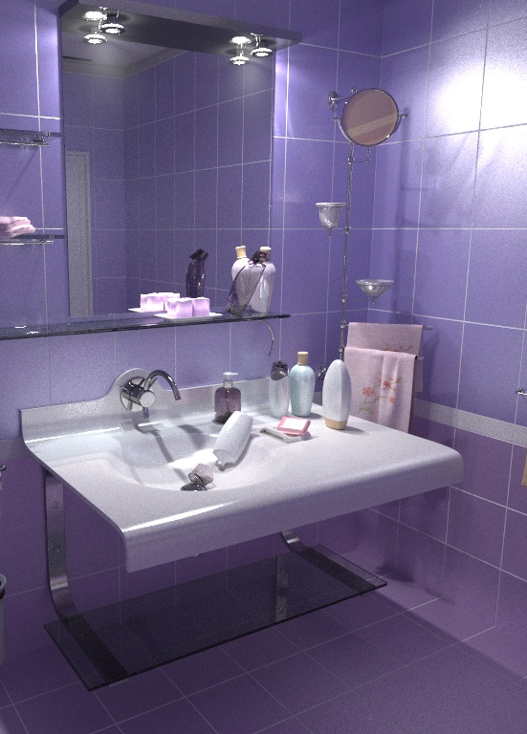
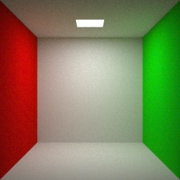
Advanced Light Transport why
However current techniques are not enough
?
Recent Advances in Light Transport Simulation: Theory & Practice
Notes:
However, despite the fact that current techniques are very good, they are not enough for rendering every kind of scenario. Many scenes require a lot of time to render, or the use of counterintuitive parameters to change the convergence of the rendering algorithm (i.e. bounces, light samples, etc). A lot of work still needs to be done in the search for a good balance between simple scenes and corner cases; meanwhile it is better that a render engine provides robustness in the majority of situations, rather than good performance sporadically.

Slide 5
Advanced Light Transport why
Are recent advances in light transport used by the industry?
- The majority of the industry is using old techniques
- A large percentage of current commercial renderers are PTs with MIS (1996)
- Lighting TDs have learned to optimize scenes avoiding difficult scenarios
Recent Advances in Light Transport Simulation: Theory & Practice
Notes:
Are recent advances in light transport used by the industry?: No.
The majority of commercial renderers are really not getting the most of the state of the art know-how in light transport. In fact many of them are just path tracers with multiple importance sampling (MIS), a technique published in papers almost 20 years ago. Few renders go beyond and make use of bidirectional path tracer, metropolis light transport, vertex merging and other more modern techniques.
Lighting artists have learned to optimize scenes to be used with path tracers with MIS (i.e replacing complex lighting with IBL lighting, avoiding interiors, complex scenarios with too many reflective/refractive surfaces, etc).
It is also worth mentioning that in many cases, disruptive changes are not adopted quickly. Professionals have invested years in learning how to use specific rendering techniques and know how to control the parameters in order to optimize render times or reduce artifacts. Complex rendering pipelines have been built on top of these rendering methods. Therefore new techniques that require different approaches take time before they become standard (i.e. physically based rendering has been commercially available for a long time, but only recently has it become very popular).

Slide 6
Advanced Light Transport problems
Why are these methods not used more often?
- Performance/Robustness
- Implementation issues
- Iteration
Recent Advances in Light Transport Simulation: Theory & Practice
Notes:
When discussing which rendering algorithm is better, most of the time the discussion is focused solely on convergence and performance. However there are other aspects that are equally important, such the difficulty of implementation or the appearance of the image while it converges.

Slide 7
Advanced Light Transport problems
Performance issues:
- Robustness vs corner case scenarios
- Multithreading/SIMD issues
Recent Advances in Light Transport Simulation: Theory & Practice
Notes:
Performance issues:
Some of the rendering algorithms mentioned here (specifically the ones based in metropolis light transport - MLT), behave well in some scenarios but poorly in many others.
While these techniques have a lot of relevance from the researcher perspective it is often more desirable for a commercial renderer to sacrifice performance in corner case scenarios in order to be more robust and generic. Performance in simple scenes is critical, because users simplify scenes for rendering. Finding a way for the engine to behave well in complex scenes, while maintaining performance in simpler ones at the same level as basic path tracers, is one of the main open challenges.
Also, these implementations usually need the developer to adjust internal parameters within the render engine, which dramatically affect performance, such how many mutations are done, and how and when they expand to neighbor pixels.
Also regarding performance, MLT algorithms are less SIMD/GPU friendly than simpler approaches. Depending how the mutation system works, it is very likely that calculations in some areas of the image are several orders of magnitude more expensive than in others. It is precisely because of the nature of the exploration/mutations, that the parallelization of the algorithms become more complex and less efficient.

Slide 8
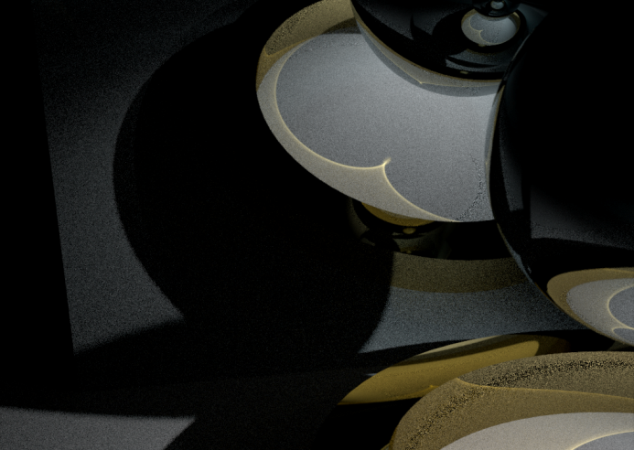
Advanced Light Transport problems
Implementation issues:
- MLT/ERT, etc implementations are convoluted
- Commercial renderers have to implement features on top
- Debugging is not fun
Recent Advances in Light Transport Simulation: Theory & Practice
Notes:
Implementation issues:
The implementation of BPT/ERT/MLT based algorithms is significantly more convoluted than other approaches.
The problem gets worse because commercial renderers have to implement a huge amount of features that are not taken into account in non-commercial ones. Namely implementing things as matte objects, shadow passes with GI, additive (even non energy conserving) materials, etc. These all add a layer of complexity on top of something that is already difficult to debug and maintain.
Debugging can also be extremely tricky, totally leaving the geometry domain and entering a whole new fun universe of joy.

Slide 9
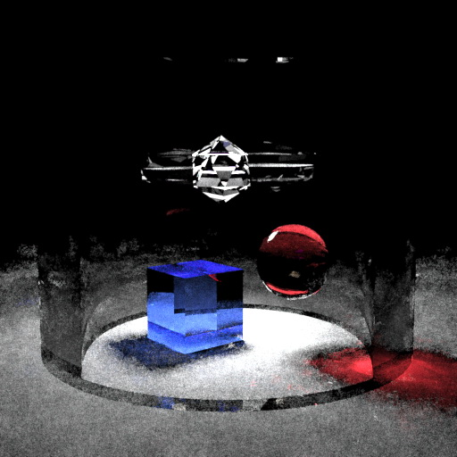
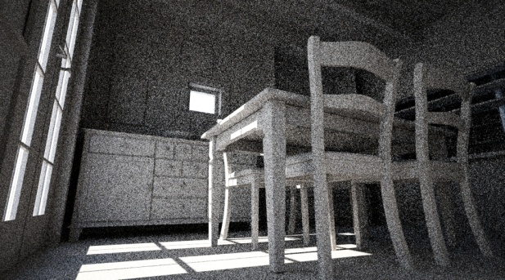
Advanced Light Transport problems
Iteration issues:
- Most of the renders are tests
- The user has to get feedback quickly
- Convergence of MLT might not be visually appealing
- Coherence vs Iteration (quick preview vs path exploration)
Recent Advances in Light Transport Simulation: Theory & Practice
Notes:
One aspect that is usually not mentioned is how these algorithms iterate (in other words, how the render progress is shown).
Almost all the renders done by an artist are trial & error, not final images. They need quick results. In these cases techniques such as path tracing or bidirectional path tracing may be less capable of solving the difficulties of the scene, but provide a more consistent look that might give more useful information so the artist can make decisions and iteratively adjusts parameters. MLT techniques, on the other hand, can be visually less appealing than pure path tracers, which show the render progress more or less equally in the whole image
Precisely the strength of mutation-based engines, which is exploring coherence efficiently, introduces a problem here. Most of the time, the image does not converge homogeneously but some areas clean much faster than others. This pollutes the image with a characteristic patches-based look that is less pleasing for users.
Coherence vs Iteration: It is not mentioned often but this is one of the main open problems to be solved. The faster we want the preview, the less each patch should explore.

Slide 10
Advanced Light Transport problems
Iteration issues
Quick preview
vs
Efficient mutations
Recent Advances in Light Transport Simulation: Theory & Practice
Notes:
See videos (convergence_1 & convergence_2) which show different ratios of time spent per pixel. While “convergence_1” produces an image with more noise, it quickly gives an overall idea of how the image will look. “convergence_2” spends more time on each region so they get cleaner faster, but the rest of the image remains black.

Slide 11
Advanced Light Transport problems
Recent Advances in Light Transport Simulation: Theory & Practice
Notes:
The video “convergence_3” shows the same scene as in the previous videos but using a bidirectional path tracing instead. There is less information in the scene but a better look from the beginning. It is easier to make decisions based on this image than on one with a few buckets clean surrounded by too many dark areas.

Slide 12
Advanced Light Transport next steps
- More research is needed
- Hybrid methods (preview vs final look)
Recent Advances in Light Transport Simulation: Theory & Practice
Notes:
In real life there are still many areas where current rendering technologies are not powerful enough to provide generic solutions viable for commercial applications. More research is needed, this is an open problem. Biased solutions can solve some of these problems but restrict the scope of these techniques to visualization/artistic purposes, so the render engine cannot be used as a design tool or produce reliable photometric data.
Latest relevant contributions: Manifold exploration, Vertex connection and merging. More work is needed following the same philosophy: ”Parameter Control for Metropolis Light Transport “( Zsolnai, Laszlo).

Slide 13
Advanced Light Transport questions
Questions
Thanks!
Recent Advances in Light Transport Simulation: Theory & Practice

